Slide 1





CS19P11 Internet Of Things Essential
SOIL MOISTURE MONITORING SYSTEM
BHUVANESH C S (210701042)
EASWARAN T (210701058)
GOKULA KRISHNA (210701062)
MR.S.SURESH KUMAR
SUPERVISOR
DEPARTMENT OF COMPUTER SCIENCE ENGINEERING

Slide 2
Abstract
This project presents an IoT-based Soil Moisture Monitoring System designed to optimize irrigation by providing real-time soil moisture data. Utilizing a soil moisture sensor connected to a microcontroller, the system measures soil moisture levels and indicates the status through LEDs: blue for low moisture, red for high moisture, and green for optimal moisture. This setup allows for quick visual assessment and appropriate irrigation adjustments. Additionally, the system can transmit data to an IoT platform for remote monitoring and logging via web or mobile applications. By ensuring precise irrigation control, this system promotes efficient water usage and enhances agricultural productivity.The core components of the system include a soil moisture sensor, an IoT module for data transmission, and LEDs for visual indication. The soil moisture sensor continuously monitors the moisture content in the soil and sends the data to the microcontroller. Based on predefined threshold values, the microcontroller processes the data and triggers the corresponding LED. For remote monitoring and data logging, the system can be connected to an IoT platform, enabling users to track soil moisture levels over time through a web or mobile application.The implementation of this system provides a cost-effective and efficient solution for precise irrigation control, which is crucial for optimizing water usage in agriculture and gardening.

Slide 3
Problem Statement
Inefficient water management in agricultural practices often leads to suboptimal crop yields, water wastage, and environmental degradation. Existing soil moisture monitoring systems lack comprehensive real-time data acquisition, analysis, and decision support capabilities, hindering farmers' ability to make timely and informed irrigation decisions. Additionally, current systems may lack scalability, affordability, and user-friendly interfaces, limiting their adoption and effectiveness in diverse agricultural settings. There is a pressing need for the development of an integrated soil moisture monitoring system that offers robust sensor technology, efficient data acquisition and analysis, user-friendly interfaces, and scalable solutions to optimize water usage, improve crop productivity, and promote sustainable agricultural practices.There is a need for a reliable, real-time monitoring system that can provide accurate soil moisture data and guide appropriate irrigation practices.This project addresses this problem by developing an IoT-based Soil Moisture Monitoring System that offers continuous monitoring and clear visual indicators to ensure optimal soil moisture levels, thereby promoting sustainable water management and improving agricultural productivity.

Slide 4
Existing System
Electronic soil moisture sensors have improved efficiency in soil moisture monitoring. Resistive soil moisture sensors, commonly used in many systems, measure the soil's electrical resistance, which varies with moisture content. These sensors are cost-effective and simple to use, but their accuracy can be compromised by soil salinity and temperature variations. Furthermore, the metal probes in resistive sensors are prone to corrosion over time, necessitating frequent maintenance and potentially leading to inaccurate readings.
Capacitive soil moisture sensors, which measure the soil's dielectric permittivity that changes with moisture levels, offer a more advanced alternative. These sensors are more accurate and durable, as they are less affected by soil salinity and temperature fluctuations and do not rely on exposed metal parts that can corrode. Capacitive sensors are also more sensitive to small changes in moisture content, making them suitable for precise monitoring. However, they are generally more expensive and complex to integrate into monitoring systems.

Slide 5
Proposed System
The proposed IoT-based Soil Moisture Monitoring System offers a comprehensive solution to address the shortcomings of conventional soil moisture monitoring methods. Integrating capacitive soil moisture sensors with a microcontroller and IoT platform, this system provides real-time, accurate monitoring of soil moisture levels. By utilizing capacitive sensors, known for their high accuracy and durability, the system ensures reliable data collection across diverse soil conditions while minimizing maintenance requirements. LED indicators offer immediate visual feedback on soil moisture status, while remote monitoring capabilities enable users to access data and receive alerts via web or mobile applications. This user-friendly interface empowers farmers and gardeners to make informed irrigation decisions, optimizing water usage and enhancing crop productivity. With its potential to support sustainable agricultural practices, the proposed system stands poised to revolutionize soil moisture management in both large-scale farming operations and small-scale gardening endeavors.

Slide 6
Components Required
COMPONENTS
Arduino Uno board
Connecting wires
Capacitive soil Moisture sensor version 2
Indicators: led light (red ,green, blue)
Monitor ( display output) through Arduino app

Slide 7
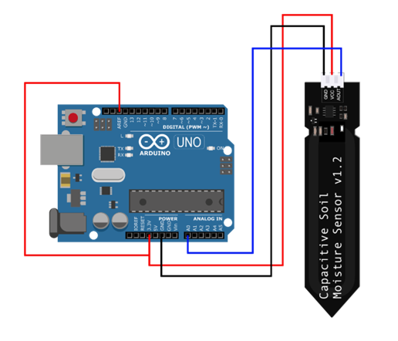
Architecture

Slide 8
Working Principle
The IoT-based Soil Moisture Monitoring System operates on the principle of continuous data collection, processing, and remote accessibility to facilitate efficient irrigation management. Capacitive soil moisture sensors embedded in the soil measure changes in dielectric permittivity, representing variations in moisture content. These measurements are transmitted to a microcontroller, which interprets the data and triggers corresponding LED indicators to visually represent soil moisture levels in real-time. Simultaneously, the microcontroller sends the data to an IoT module for transmission to an IoT platform, enabling remote monitoring via web or mobile applications. Users can access current soil moisture readings, historical data trends, and receive alerts to make informed irrigation decisions regardless of their location. This system ensures proactive management of soil moisture, optimizing water usage and promoting sustainable agricultural practices.Furthermore, the system facilitates data logging and analysis, empowering users to identify trends and patterns in soil moisture dynamics over time, ultimately enhancing agricultural productivity and resource efficiency.

Slide 9
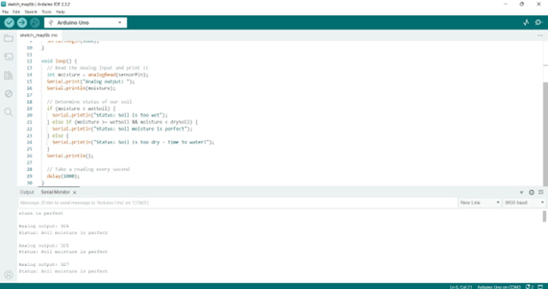
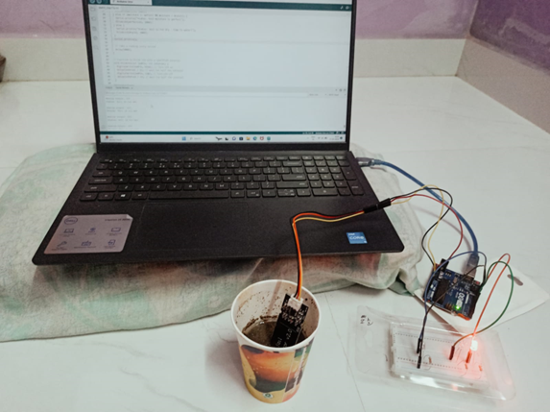
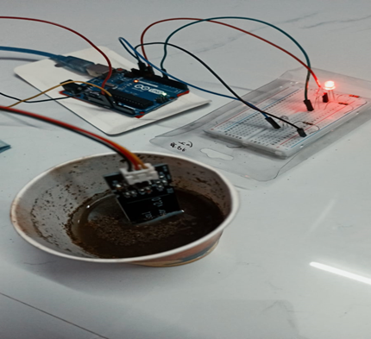
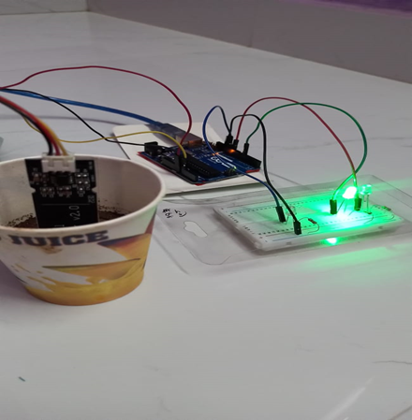
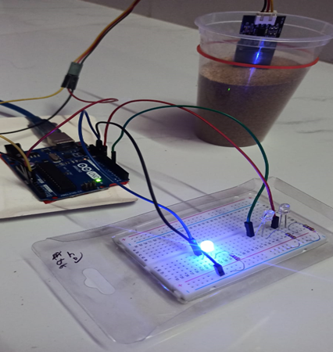
Result

Slide 10
Conclusions
In conclusion, the IoT-based Soil Moisture Monitoring System represents a significant advancement in soil moisture management, offering a comprehensive solution for precision agriculture and sustainable gardening practices. By integrating capacitive soil moisture sensors with microcontrollers and IoT technology, the system provides accurate, real-time monitoring of soil moisture levels across diverse environmental conditions. The immediate visual feedback through LED indicators and remote access to data via the IoT platform empower users to make informed irrigation decisions, optimizing water usage and enhancing crop productivity. With its decentralized sensor data processing architecture and centralized data aggregation capabilities, the system offers scalability, responsiveness, and analytical insights crucial for large-scale farming operations and small-scale gardening endeavors alike. By promoting efficient water management and supporting sustainable agricultural practices, the IoT-based Soil Moisture Monitoring System contributes to resource conservation, crop resilience, and long-term environmental sustainability. As agriculture faces increasing challenges from climate change and water scarcity, this innovative monitoring system emerges as a valuable tool to meet the evolving needs of modern agriculture and ensure food security for future generations.

Slide 11
Thank You

